Slide 1
Yes We Code!
CS Capstone Project
By Alana Allbritton
Git Repository Link

Slide 2


Project: Yes We Code!
An educational application that teaches youth the foundations of programming
Module (6 lessons)
Two activities: Quiz Game and Music Game

Slide 3


Why this project?
Passion for youth development projects
Provide alternative coding introduction
Help eliminate the stigma that programming is “too difficult to understand”

Slide 4


Intermediate Milestone
Diagrams:
Class Diagram
Application Mapping
Mockups:
Start Screen
Lesson Selection
Lesson Display
Game Selection
Quiz Game Display
Music Game Display

Slide 5
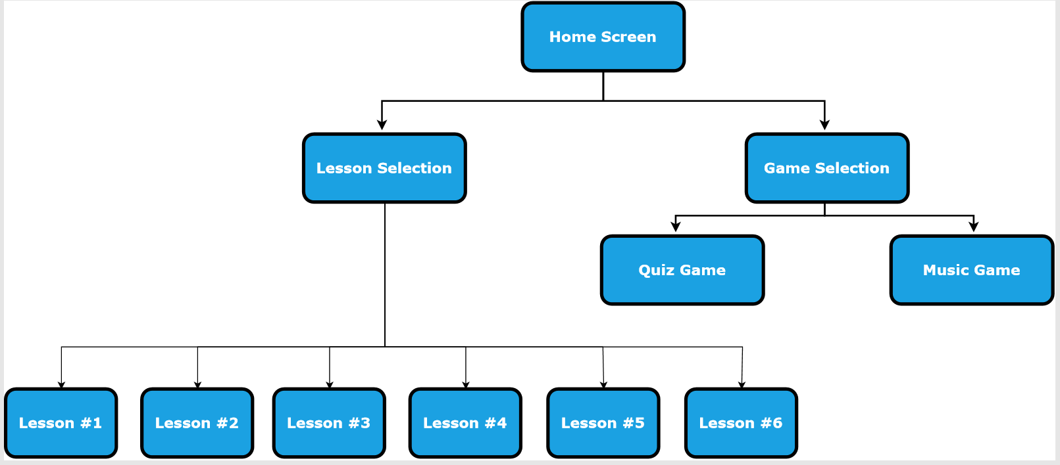
Progress: Application Mapping

Slide 6
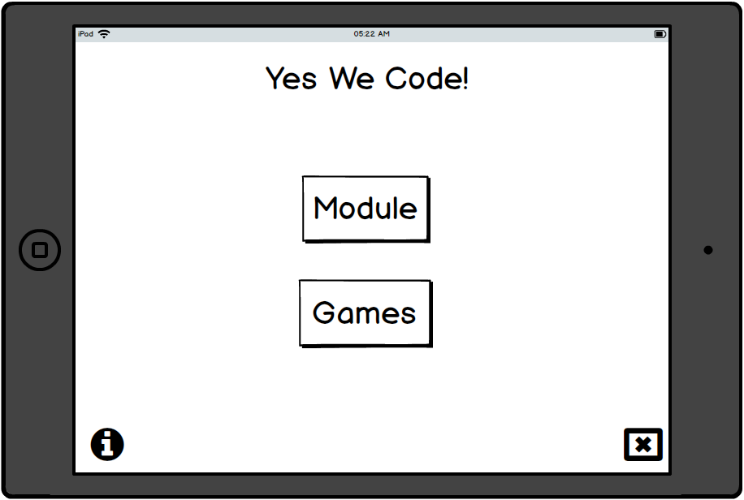
Mockups: Start Screen

Slide 7
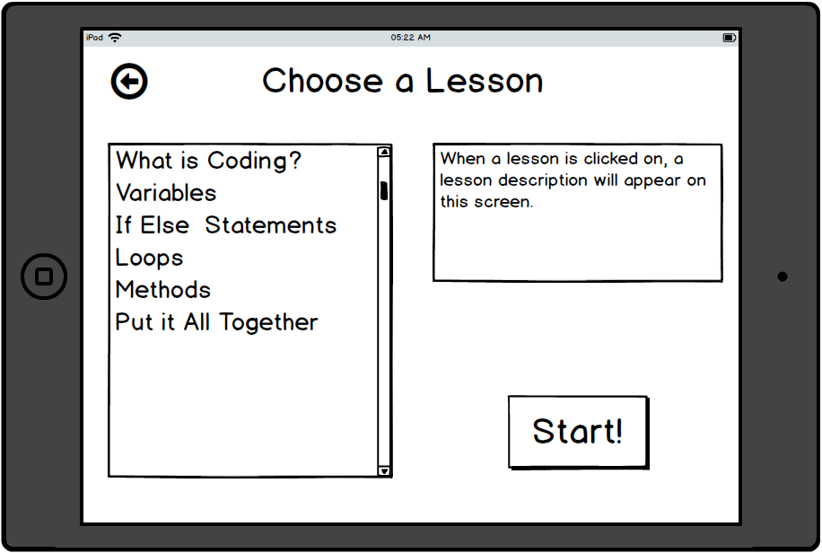
Mockups: Lesson Selection

Slide 8
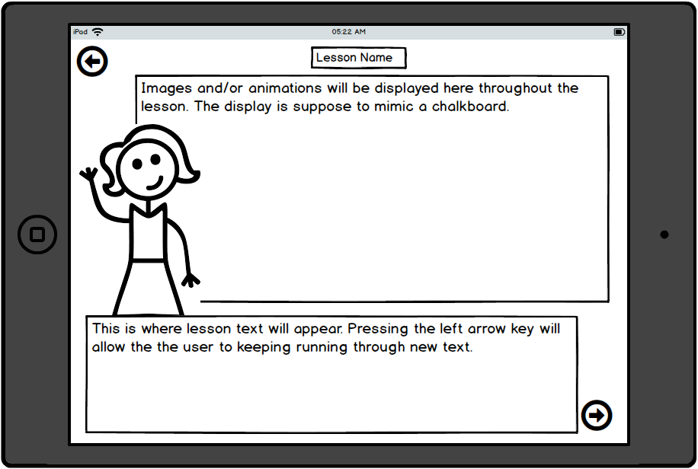
Mockups: Lesson Display

Slide 9
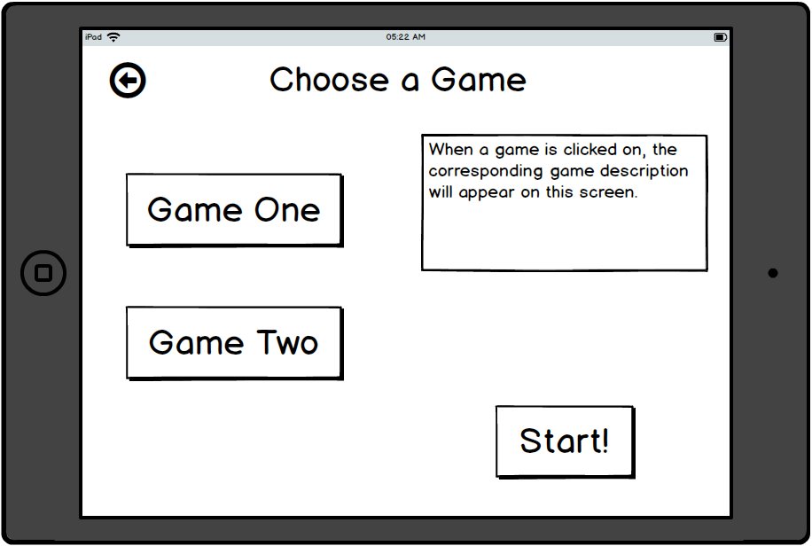
Mockups: Game Selection

Slide 10
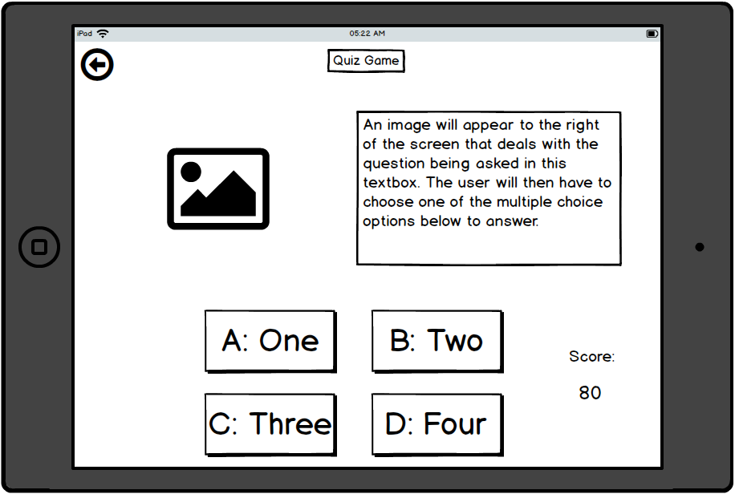
Mockups: Quiz Game

Slide 11
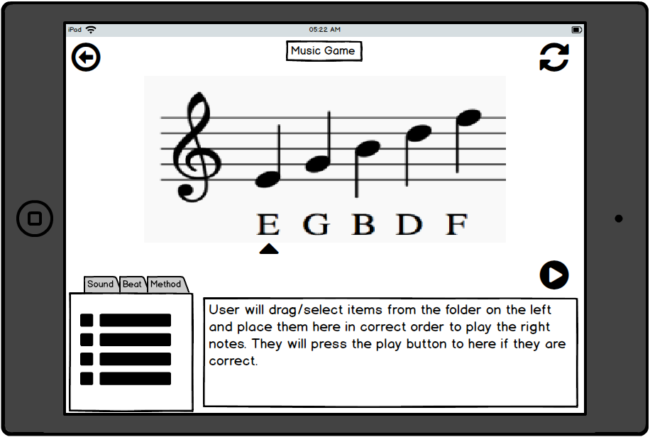
Mockups: Game Display

Slide 12
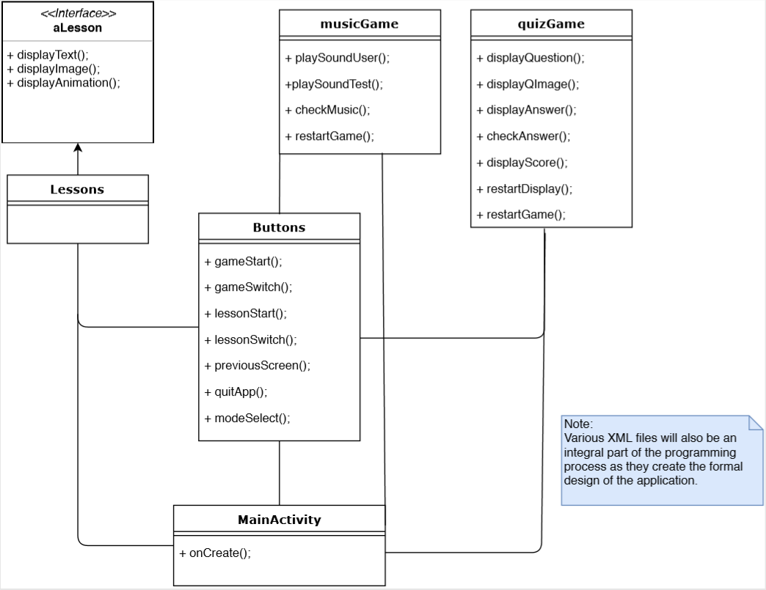
Progress: Simplified Class Diagram

Slide 13


What Next?
Start application coding in Android Studio
Layout and Display
Game mechanics
Animations and Visuals

